Slide 1


CSE431
Group 10
Sania Azhmee Bhuiyan 18101486
Arnob Rahee 18101225

Slide 2

Sentiment Analysis of Bengali Movie Reviews
Sania Azhmee Bhuiyan
Department of Computer Science and Engineering.
Brac University
Dhakha, Bangladesh.
sania.azhmee.bhuiyan@g.bracu.ac.bd
Arnob Rahee
Department of Computer Science and Engineering.
Brac University
Dhakha, Bangladesh.
arnob.rahee@g.bracu.ac.bd
Md Sabbir Hossain
Department of Computer Science and Engineering.
Brac University
Dhaka, Bangladesh
md.sabbir.hossain1@g.bracu.ac.bd
Supervisor:
Annajiat Alim Rassel
Lecturer
Department of Computer Science and Engineering
Brac University
Dhaka, Bangladesh
annajiat@gmail.com

Slide 3
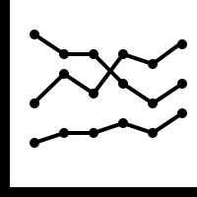


Problem Statement
When a movie/drama is launched an important aspect of information gathering has always been to perceive what users think. With the growing availability of opinion rich resources, more chances and challenges arise to actively use information technologies to seek out and understand the view of others.
Aims and Objective
Data preprocessing and filtering
Application of algorithms and sentiment analysis (NLP and ML)
Comparing different techniques to understand which is most suitable

Slide 4


Literature Review
Techniques
Constructing lexical chain for processing text in sentiment analysis
Statistical approaches like domain knowledge driven analysis
Another paper used English–Bengali dictionary for creating a sentiwordnet for Bengali which consisted of 35,805 words created by them
One paper proposed a strategy for Tamil language. Three approaches are followed by their strategies which were: In-language Sentiment Analysis, Machine Translation, Resource based sentiment analysis.
Discovery
They developed a Tamil SentiWordnet (TSWN) by replacing words of English wordnet by their Tamil equivalents as it was inconsistent with English wordnet
A paper was able to get the better improved results by using SVM approaches and ML algorithms

Slide 5


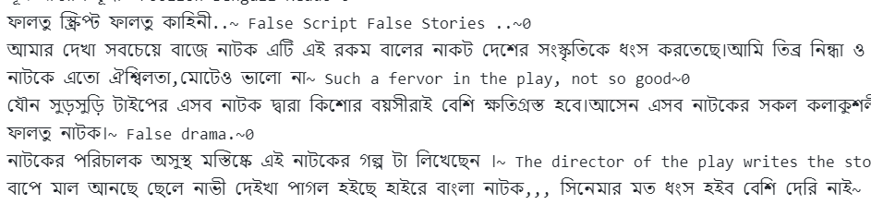
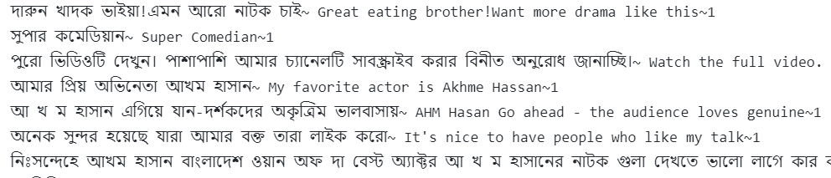
Data preprocessing and filtering
Remove stopwords and special symbols
Splitting the review into positive, negative and neutral
Dataset
Preprocessed and filtered dataset

Slide 6
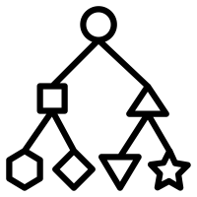
Classification
A machine Learning approach is taken for the implementation algorithms for training and accuracy purpose. The algorithms were;
Random forest is a group learning method for the task of classification that operates by creating decision trees at training time
SVM stands for Support Vector Machine. It is a learning model with associated learning algorithm that examines the data for classification purpose.

Slide 7
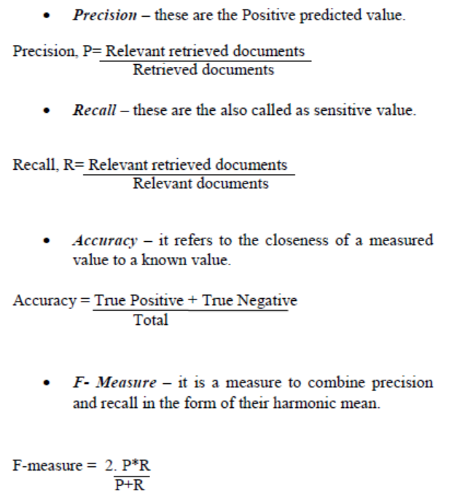

Performance Evaluation
The final step of the sentiment analysis process for the Bangla movie review is performance evaluation. In this the performance would be evaluated on the basis of different
metrics such as “Precision”, “Recall”, “Accuracy” and “Fmeasure”

Slide 8

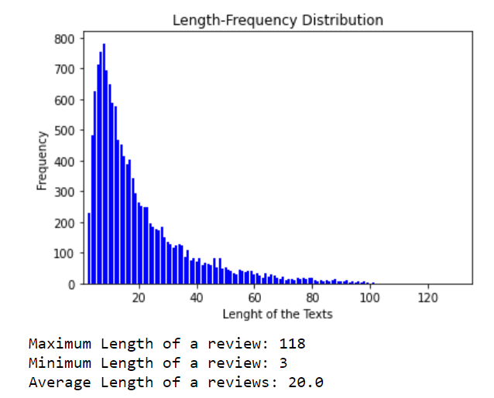
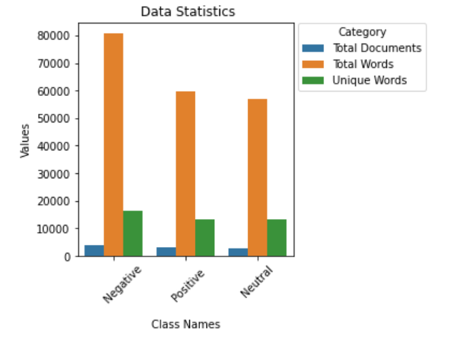
Results: classification

Slide 9
 | Algorithm | Dataset | Parameter | Result (in %)
Approach 1 | Resource Based Machine Learning | Lexical Resources Annotated Nepali Text | Precision Recall Precision Recall | 47.2 54.8 23.6 70.2
Approach 2 | SVM NB | IMDB.com -------------------- | Accuracy | 89.65 72.41
Proposed Approach | RF | YouTube.com Facebook.com | Precision Recall F-Measure Accuracy | 88.77 87.97 88.53 91.07
 | SVM | YouTube.com Facebook.com | Precision Recall F-Measure Accuracy | 88.77 87.97 88.53 89.73
Results: Machine learning algorithms
The table on the right compares the Machine Learning approach between two of the approaches discussed in the papers of related work.

Slide 10

Conclusion
The suggested method would divide the reviews into three categories: positive and negative and neutral, as well as evaluate the performance of by using an algorithm using various metrics This would make things a lot easier for the user to determine the review's polarity and therefore the user's time is saved.
The classification method to be used is machine learning which is widely used approach with lot of advantages over the rest of the methodologies. This is used to predict the polarity of the sentiments based on the dataset.

Slide 11


Limitation
Not enough datasets could be found, some of the datasets were manually taken from the internet, cleaning and filtering was time consuming.
Incapability to deal with complex sentences that require more than sentiment words and simple analyzing, there were some metaphors and idiom this was not able to understand despite the bangla-senti wordnet
Future work
The work can also be expanded upon by doing a comparative analysis of various algorithms in order to determine which method is best suited for the classification task.
Work has been accomplished by researchers in many different languages such as Thai, Nepali, Malayalam etc. But very small amount of work has been done in Bangladesh

